Slide 1
HE1001
Week 8
Dong An
dong0128@e.ntu.edu.sg

Slide 2
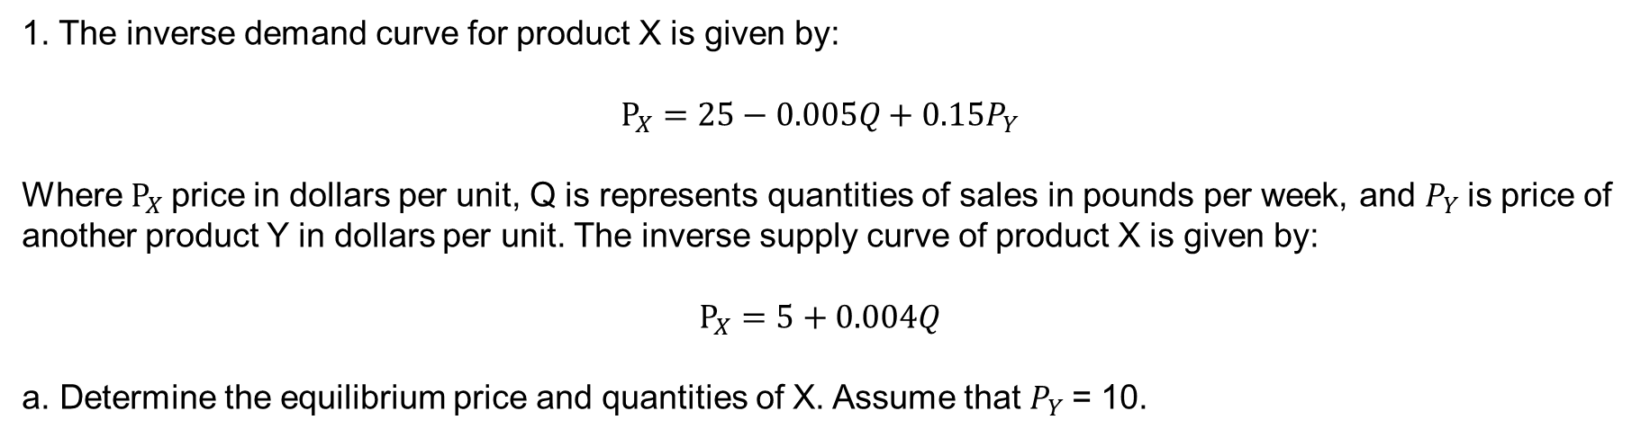
Question 1
1. The inverse demand curve for product X is given by:
$$P_{X}=25−0.005Q+0.15P_{Y}$$
Where $P_{X}$price in dollars per unit, Q is represents quantities of sales in pounds per week, and $P_{Y}$is price of another product Y in dollars per unit. The inverse supply curve of product X is given by:
$$P_{X}=5+0.004Q$$
a. Determine the equilibrium price and quantities of X. Assume that $P_{Y}$= 10.

Slide 3
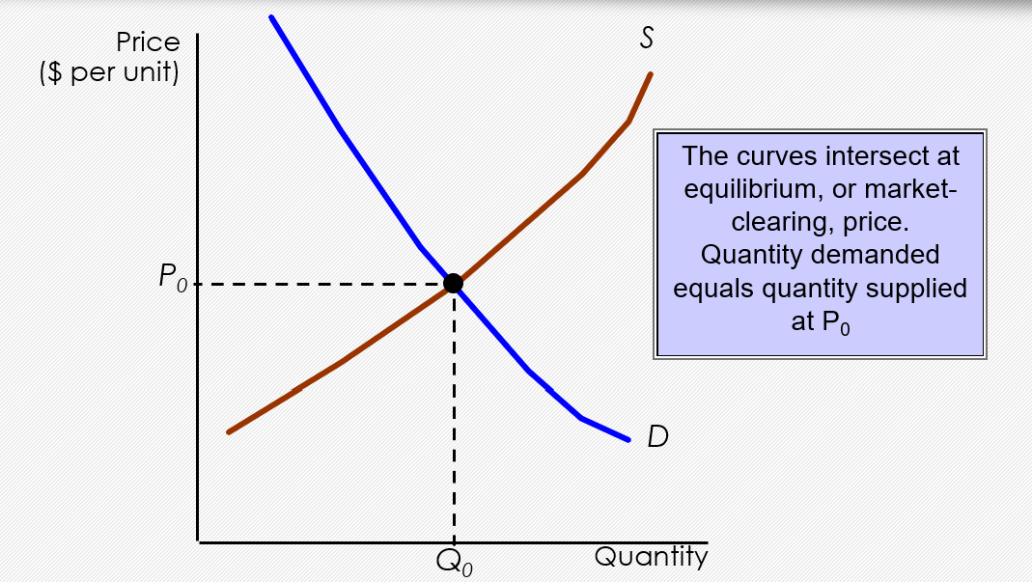
Question 1
1. The inverse demand curve for product X is given by:
$$P_{X}=25−0.005Q+0.15P_{Y}$$
Where $P_{X}$price in dollars per unit, Q is represents quantities of sales in pounds per week, and $P_{Y}$is price of another product Y in dollars per unit. The inverse supply curve of product X is given by:
$$P_{X}=5+0.004Q$$
a. Determine the equilibrium price and quantities of X. Assume that $P_{Y}$= 10.

Slide 4
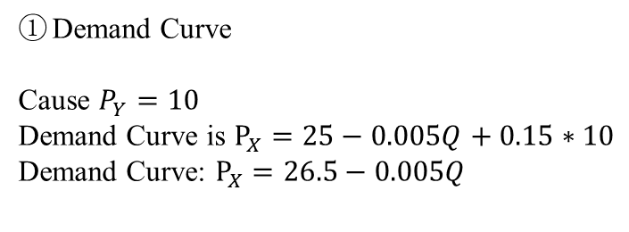
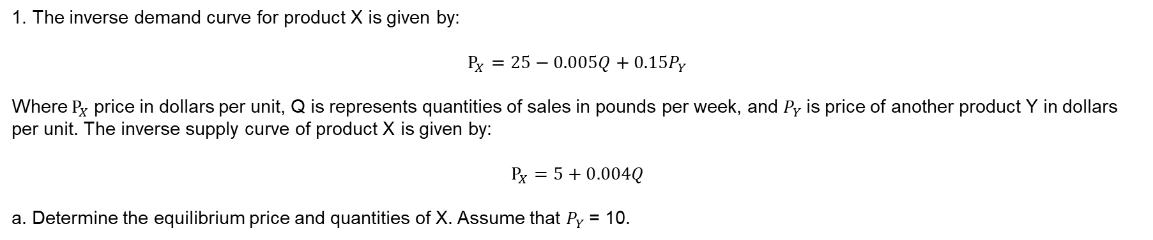
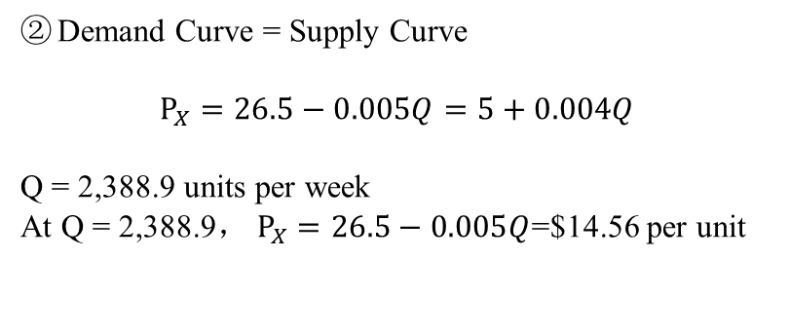
Question 1
1. The inverse demand curve for product X is given by:
$$P_{X}=25−0.005Q+0.15P_{Y}$$
Where $P_{X}$price in dollars per unit, Q is represents quantities of sales in pounds per week, and $P_{Y}$is price of another product Y in dollars per unit. The inverse supply curve of product X is given by:
$$P_{X}=5+0.004Q$$
a. Determine the equilibrium price and quantities of X. Assume that $P_{Y}$= 10.
Answer:
Demand Curve
Cause $P_{Y}=10$
Demand Curve is $P_{X}=25−0.005Q+0.15∗10$
Demand Curve: $P_{X}=26.5−0.005Q$
Demand Curve = Supply Curve
$$P_{X}=26.5−0.005Q=5+0.004Q$$
Q = 2,388.9 units per week
At Q = 2,388.9， $P_{X}=26.5−0.005Q$=$14.56 per unit

Slide 5
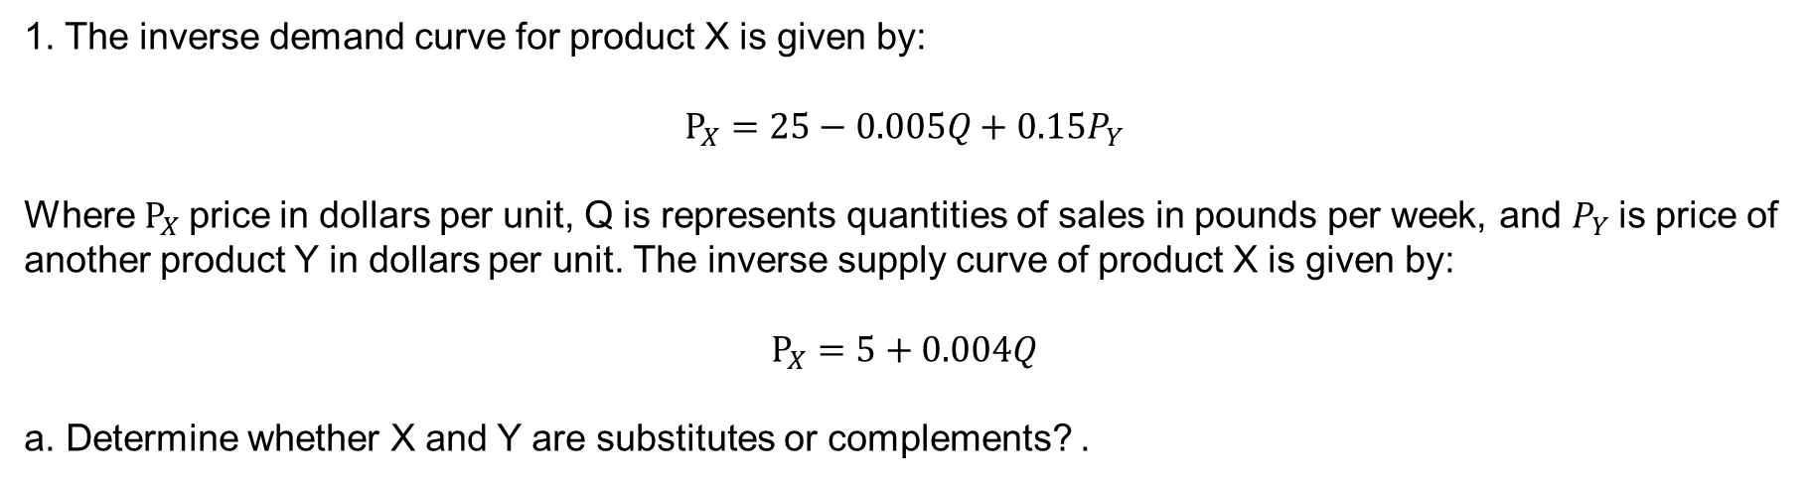
Question 1
1. The inverse demand curve for product X is given by:
$$P_{X}=25−0.005Q+0.15P_{Y}$$
Where $P_{X}$price in dollars per unit, Q is represents quantities of sales in pounds per week, and $P_{Y}$is price of another product Y in dollars per unit. The inverse supply curve of product X is given by:
$$P_{X}=5+0.004Q$$
a. Determine whether X and Y are substitutes or complements? .

Slide 6
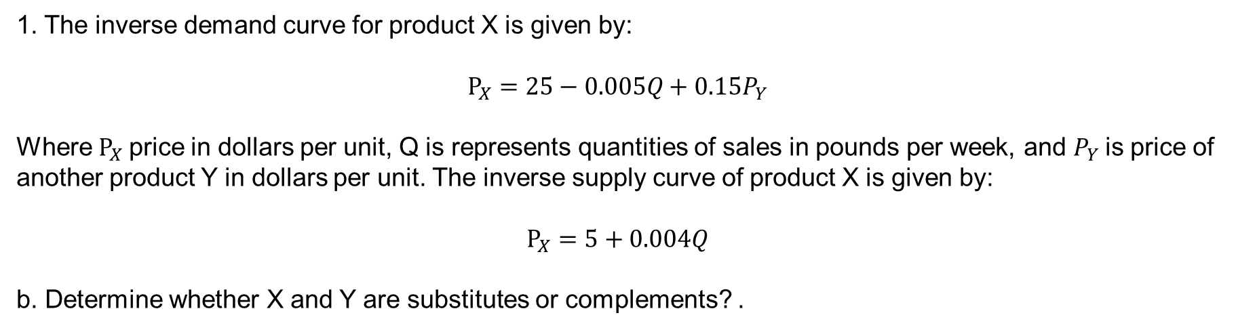
Question 1
1. The inverse demand curve for product X is given by:
$$P_{X}=25−0.005Q+0.15P_{Y}$$
Where $P_{X}$price in dollars per unit, Q is represents quantities of sales in pounds per week, and $P_{Y}$is price of another product Y in dollars per unit. The inverse supply curve of product X is given by:
$$P_{X}=5+0.004Q$$
b. Determine whether X and Y are substitutes or complements? .
Cross-Price Elasticity of Demand
Complements: Cross-price elasticity of demand is negative
Substitutes: Cross-price elasticity of demand is positive

Slide 7
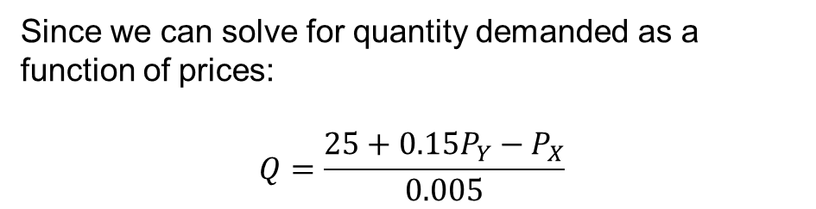
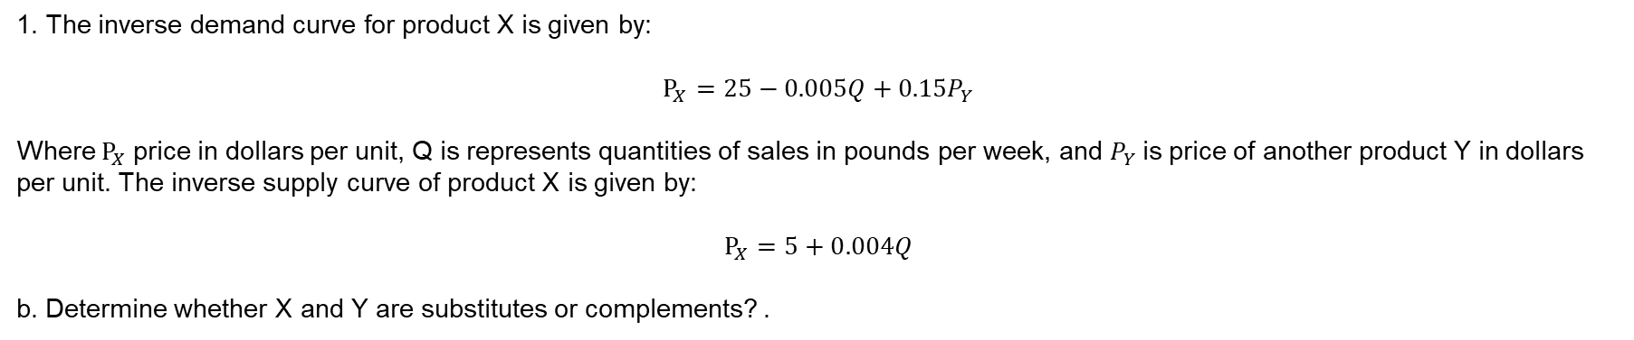
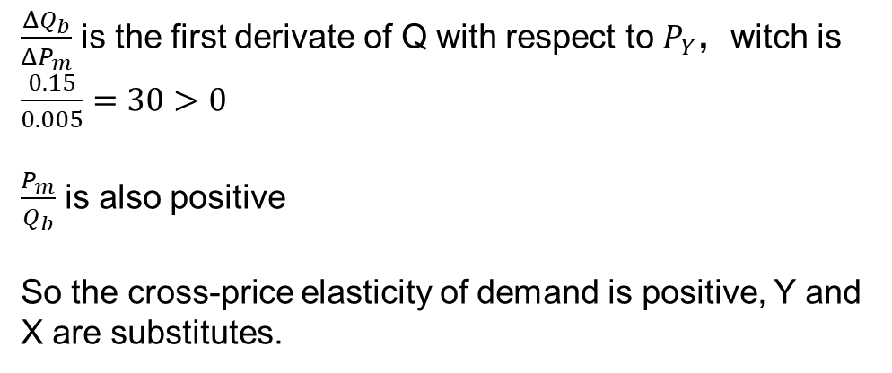
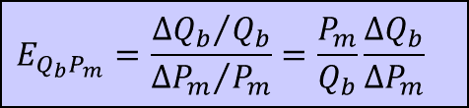
Question 1
1. The inverse demand curve for product X is given by:
$$P_{X}=25−0.005Q+0.15P_{Y}$$
Where $P_{X}$price in dollars per unit, Q is represents quantities of sales in pounds per week, and $P_{Y}$is price of another product Y in dollars per unit. The inverse supply curve of product X is given by:
$$P_{X}=5+0.004Q$$
b. Determine whether X and Y are substitutes or complements? .
Answer:
$$E_{Q_{b}P_{m}}=\frac{{ΔQ_{b}}/{Q_{b}}}{{ΔP_{m}}/{P_{m}}}=\frac{P_{m}}{Q_{b}}\frac{ΔQ_{b}}{ΔP_{m}}$$
Since we can solve for quantity demanded as a function of prices:
$$Q=\frac{25+0.15P_{Y}−P_{X}}{0.005}$$
$\frac{ΔQ_{b}}{ΔP_{m}}$ is the first derivate of Q with respect to $P_{Y}$，witch is $\frac{0.15}{0.005}=30>0$
$\frac{P_{m}}{Q_{b}}$ is also positive
So the cross-price elasticity of demand is positive, Y and X are substitutes.

Slide 8
Question 1
1. The inverse demand curve for product X is given by:
$$P_{X}=25−0.005Q+0.15P_{Y}$$
Where $P_{X}$price in dollars per unit, Q is represents quantities of sales in pounds per week, and $P_{Y}$is price of another product Y in dollars per unit. The inverse supply curve of product X is given by:
$$P_{X}=5+0.004Q$$
b. Determine whether X and Y are substitutes or complements? .
Answer:
Since we can solve for quantity demanded as a function of prices:
$$Q=\frac{25+0.15P_{Y}−P_{X}}{0.005}$$
We see that there is a direct, positive relationship between Q and PY. An increase in the price of good Y generates an increase in the quantity demanded for good X at any value of PX, which implies that goods Y and X are substitutes.

Slide 9
Question 2
2. Suppose the demand curve for a product is given by Q=300-2P+4I, where I is average income measured in thousands of dollars. The supply curve is Q=3P-50.
a. If I=25, find the market clearing price and quantity for the product.

Slide 10
Question 2
2. Suppose the demand curve for a product is given by Q=300-2P+4I, where I is average income measured in thousands of dollars. The supply curve is Q=3P-50.
a. If I=25, find the market clearing price and quantity for the product.
Answer:
Given I=25, the demand curve becomes Q=300-2P+4*25, or Q=400-2P.
Setting demand equal to supply we can solve for P and then Q:
400-2P=3P-50
P=90
Q=220.

Slide 11
Question 2
2. Suppose the demand curve for a product is given by Q=300-2P+4I, where I is average income measured in thousands of dollars. The supply curve is Q=3P-50.
b. If I=50, find the market clearing price and quantity for the product.

Slide 12
Question 2
2. Suppose the demand curve for a product is given by Q=300-2P+4I, where I is average income measured in thousands of dollars. The supply curve is Q=3P-50.
b. If I=50, find the market clearing price and quantity for the product.
Answer:
Given I=50, the demand curve becomes Q=300-2P+4*50, or Q=500-2P.
Setting demand equal to supply we can solve for P and then Q:
500-2P=3P-50
P=110
Q=280.

Slide 13
Question 2
2. Suppose the demand curve for a product is given by Q=300-2P+4I, where I is average income measured in thousands of dollars. The supply curve is Q=3P-50.
c. Draw a graph to illustrate your answers.

Slide 14
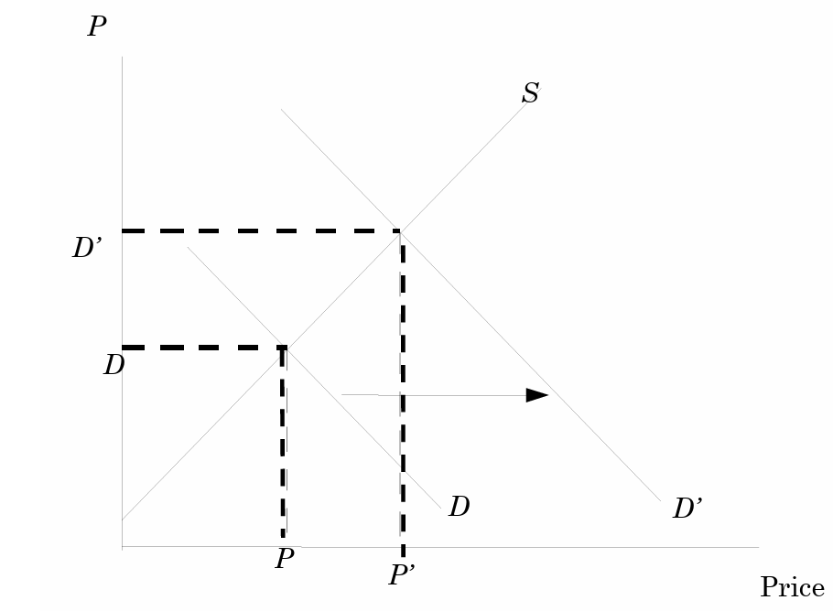
Question 2
2. Suppose the demand curve for a product is given by Q=300-2P+4I, where I is average income measured in thousands of dollars. The supply curve is Q=3P-50.
c. Draw a graph to illustrate your answers.
Answer:
Demand curve: Q=400-2P. Supply curve: Q=3P-50
Demand curve: Q=500-2P. Supply curve: Q=3P-50
Q=3P-50
Q=500-2P
Q=400-2P

Slide 15
Question 3
3. Suppose that a government of a certain country is interested in analyzing the domestic market for corn. Their economists estimate the following equations for the demand and supply curves:
Qd = 1,600 - 125P
Qs = 440 + 165P
Quantities are measured in millions of bushels; prices are measured in dollars per bushel.
a. Calculate the equilibrium price and quantity that will prevail under a completely free market.

Slide 16
Question 3
3. Suppose that a government of a certain country is interested in analyzing the domestic market for corn. Their economists estimate the following equations for the demand and supply curves:
Qd = 1,600 - 125P
Qs = 440 + 165P
Quantities are measured in millions of bushels; prices are measured in dollars per bushel.
a. Calculate the equilibrium price and quantity that will prevail under a completely free market.
Answer:
Set Qd = Qs to determine price.
1600 - 125P = 440 + 165P
1160 = 290P
P = 4
Obtain Q by substituting into either expression.
Qd = 1600 - 125(4)
Qd = 1600 - 500
Q = 1100
P* = $4, Q* = 1100

Slide 17
Question 3
3. Suppose that a government of a certain country is interested in analyzing the domestic market for corn. Their economists estimate the following equations for the demand and supply curves:
Qd = 1,600 - 125P
Qs = 440 + 165P
Quantities are measured in millions of bushels; prices are measured in dollars per bushel.
b. Calculate the price elasticities of supply and demand at the equilibrium values.

Slide 18
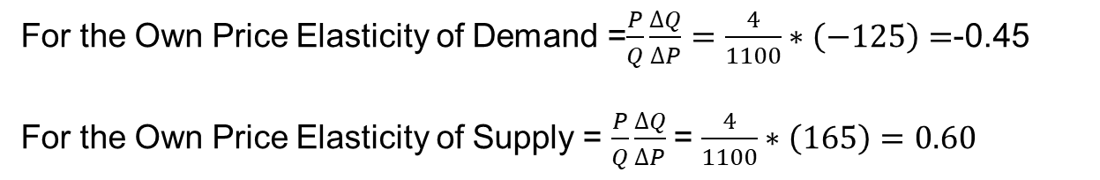
Question 3
3. Suppose that a government of a certain country is interested in analyzing the domestic market for corn. Their economists estimate the following equations for the demand and supply curves:
Qd = 1,600 - 125P
Qs = 440 + 165P
Quantities are measured in millions of bushels; prices are measured in dollars per bushel.
b. Calculate the price elasticities of supply and demand at the equilibrium values.
Equilibrium: P* = $4, Q* = 1100
price elasticities of demand
First derivative
For the Own Price Elasticity of Demand =$\frac{P}{Q}\frac{∆Q}{∆P}=\frac{4}{1100}∗\left(−125\right)=$-0.45
For the Own Price Elasticity of Supply = $\frac{P}{Q}\frac{∆Q}{∆P}$= $\frac{4}{1100}∗\left(165\right)=0.60$
price elasticities of supply
First derivative

Slide 19
Question 3
3. Suppose that a government of a certain country is interested in analyzing the domestic market for corn. Their economists estimate the following equations for the demand and supply curves:
Qd = 1,600 - 125P
Qs = 440 + 165P
Quantities are measured in millions of bushels; prices are measured in dollars per bushel.
c. The government currently has a $4.50 bushel support price in place. What impact will this support price have on the market? Will the government be forced to purchase corn under a program that requires them to buy up any surpluses? If so, how much?

Slide 20
Question 3
3. Suppose that a government of a certain country is interested in analyzing the domestic market for corn. Their economists estimate the following equations for the demand and supply curves:
Qd = 1,600 - 125P
Qs = 440 + 165P
Quantities are measured in millions of bushels; prices are measured in dollars per bushel.
c. The government currently has a $4.50 bushel support price in place. What impact will this support price have on the market? Will the government be forced to purchase corn under a program that requires them to buy up any surpluses? If so, how much?
Calculate Qd and Qs at the $4.50 price
Qd = 1600 - 125(4.5)
Qd = 1037.5
Qs = 440 + 165(4.5)
Qs = 1182.5
surplus = Qs - Qd = 1182.5 - 1037.5 = 145
P
Qs = 440 + 165P
4.5
4
Qd = 1,600 - 125P
The support price would create an excess supply of 145 million bushels that the
government might be forced to buy.
1100
Q

Slide 21
Question 4
4. Midcontinent Plastics makes 80 fiberglass truck hoods per day for large truck manufacturers.
Each hood sells for $500.00. Midcontinent sells all of its product to the large truck manufacturers. Suppose the own price elasticity of demand for hoods is 0.4 and the price elasticity of supply is 1.5.
a. Compute the slope and intercept coefficients for the linear supply and demand equations.

Slide 22
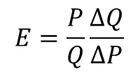
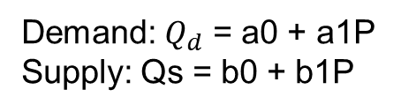

Question 4
4. Midcontinent Plastics makes 80 fiberglass truck hoods per day for large truck manufacturers.
Each hood sells for $500.00. Midcontinent sells all of its product to the large truck manufacturers. Suppose the own price elasticity of demand for hoods is 0.4 and the price elasticity of supply is 1.5.
a. Compute the slope and intercept coefficients for the linear supply and demand equations.
Answer:
Demand: $Q_{d}$ = a0 + a1P
Supply: Qs = b0 + b1P
Use
$$E=\frac{P}{Q}\frac{∆Q}{∆P}$$
to compute a1 and b1 (the slopes)
Solve for a0 and b0.
Qd = a0 + a1*P
80 = a0 + -0.064(500)
a0 = 112
Qd = 112 - 0.064P
Equilibrium price and quantity
-0.4=$\frac{500}{80}∗a_{1}$
$a_{1}$=-0.064
1.5= $\frac{500}{80}∗b_{1}$
$b_{1}$=0.24
P* = $500; Q* = 80 hoods per day
Ed = -0.40
Es = 1.5
Qs = b0 + b1*P
80 = b0 + 0.24(500)
b0 = -40
Qs = -40 + 0.24P

Slide 23
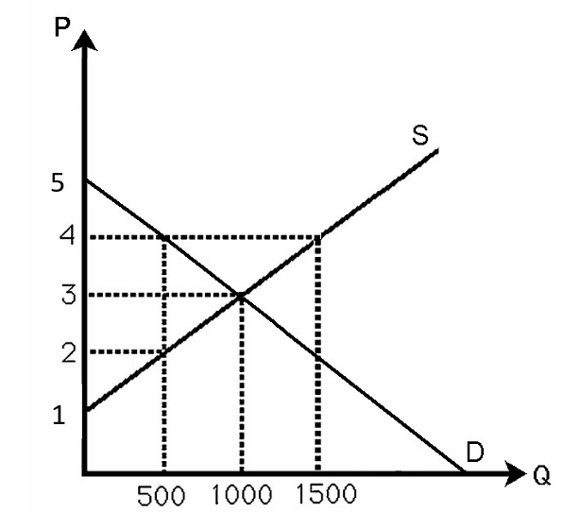
Question 1
1. The below figure shows the demand and supply curves in the market for milk.
If the government imposes a quota at 500 gallons, calculate;
a. The effect of quota on consumer surplus,

Slide 24
Question 1
1. The below figure shows the demand and supply curves in the market for milk.
If the government imposes a quota at 500 gallons, calculate;
a. The effect of quota on consumer surplus,
A
D
E
Answer:
Equilibrium price and quantity (before quota): p=3; q=1000
CS before quota = 0.5*(5-3)*(1000) = 1000
Triangle ABC
CS after quota = 0.5*(5-4)*(500) = 250
Triangle ADE
Reduction in CS = 1000 - 250 = 750.
B
C

Slide 25
Question 1
1. The below figure shows the demand and supply curves in the market for milk.
If the government imposes a quota at 500 gallons, calculate;
b. The effect of quota on producer surplus

Slide 26
Question 1
1. The below figure shows the demand and supply curves in the market for milk.
If the government imposes a quota at 500 gallons, calculate;
b. The effect of quota on producer surplus
A
D
E
Equilibrium price and quantity (before quota): p=3; q=1000
PS before quota = 0.5*(3-1)*(1000) = 1000
Triangle FBC
PS after quota = 0.5*(2-1)*500 + (4-2)*(500) = 250 + 1000 = 1250
Triangle FIG + Rectangle DEIG
Increase in PS = 1250 - 1000 = 250.
B
H
C
I
G
F

Slide 27
Question 1
1. The below figure shows the demand and supply curves in the market for milk.
If the government imposes a quota at 500 gallons, calculate;
c. The deadweight loss.

Slide 28
Question 1
1. The below figure shows the demand and supply curves in the market for milk.
If the government imposes a quota at 500 gallons, calculate;
c. The deadweight loss.
DWL = 0.5*(4 - 2)*(1000 - 500) = 500
Blue Area

Slide 29
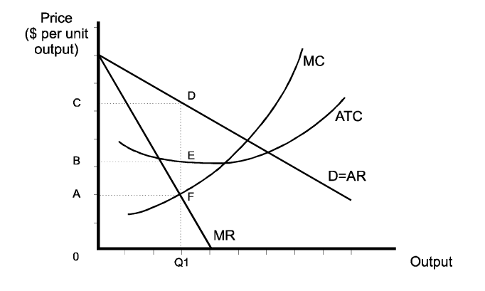
Question 2
2. Consider the following monopolist whose cost and demand curves are shown below. Assume that the monopolist produces an output of Q1. Identify the areas showing the producer surplus, consumer surplus, and deadweight loss.

Slide 30
Question 2
2. Consider the following monopolist whose cost and demand curves are shown below. Assume that the monopolist produces an output of Q1. Identify the areas showing the producer surplus, consumer surplus, and deadweight loss.
Profit = Total Revenue – Total Cost
= 0Q1DC – 0Q1EB
= BCDE
Profit = Total Revenue – Total Cost
=P*Q- ATC*Q
=(P – ATC) *Q
Area BCDE

Slide 31
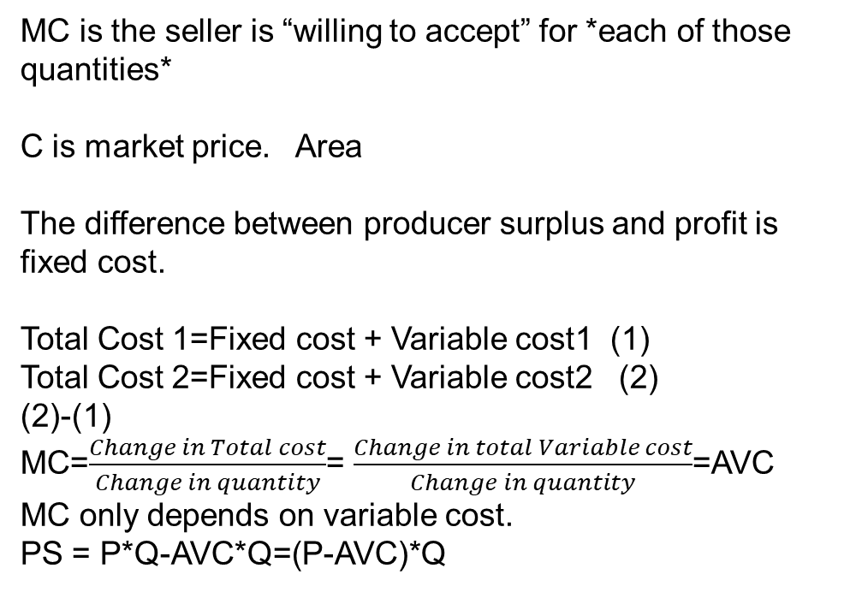
Question 2
2. Consider the following monopolist whose cost and demand curves are shown below. Assume that the monopolist produces an output of Q1. Identify the areas showing the producer surplus, consumer surplus, and deadweight loss.
Producer surplus (willing to accept and market price)
MC is the seller is “willing to accept” for *each of those quantities*
C is market price. Area
The difference between producer surplus and profit is fixed cost.
Total Cost 1=Fixed cost + Variable cost1 (1)
Total Cost 2=Fixed cost + Variable cost2 (2)
(2)-(1)
MC=$\frac{Change in Total cost}{Change in quantity}$= $\frac{Change in total Variable cost}{Change in quantity}$=AVC
MC only depends on variable cost.
PS = P*Q-AVC*Q=(P-AVC)*Q

Slide 32
Question 2
2. Consider the following monopolist whose cost and demand curves are shown below. Assume that the monopolist produces an output of Q1. Identify the areas showing the producer surplus, consumer surplus, and deadweight loss.
Profit – PS = TFC
This states that Profit – PS = TFC (“the difference between profit and producer surplus is total fixed cost”). This follows from how ATC*Q - AVC*Q = AFC*Q = TFC.

Slide 33
Question 2
2. Consider the following monopolist whose cost and demand curves are shown below. Assume that the monopolist produces an output of Q1. Identify the areas showing the producer surplus, consumer surplus, and deadweight loss.
As an aside, in PC, the upward sloping part of a firm’s MC above average variable cost AVC is its supply curve (as mentioned in the previous Lecture 8 on Competition), but we usually do not speak of supply curves for the monopolist because it is not “well-defined”, as price also depends on
demand (as we shall see in the next Lecture 9 on Monopoly) – so just call it “MC”.

Slide 34
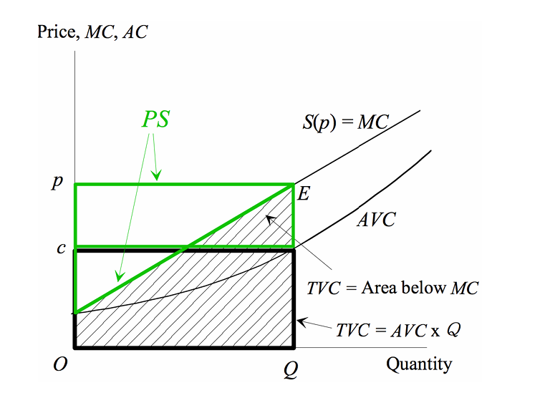
Question 2
2. Consider the following monopolist whose cost and demand curves are shown below. Assume that the monopolist produces an output of Q1. Identify the areas showing the producer surplus, consumer surplus, and deadweight loss.
Here is another way to measure PS from the perspective of cost.
This method takes the difference between the price level and the AVC level, and multiplies this difference by the quantity produced, which gives us what the seller will have to incur on average for *that particular quantity*.
This is simply PS = (P – AVC) *Q, and consistent with the method we used to measure Profit = (P – ATC) *Q in the tutorial. The *area of this rectangle* using the AVC approach is the same as the area of triangle using the MC method. The figure below illustrates the two methods, with both the big triangle and top rectangle in green indicating PS in two different ways.

